Slide 1
Digital Electronics and Systems

Slide 2

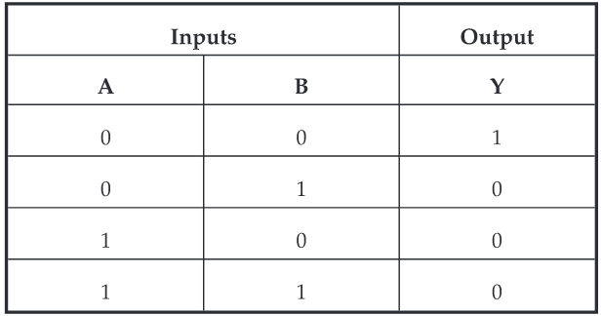
NOR gate
Truth Table

Slide 3
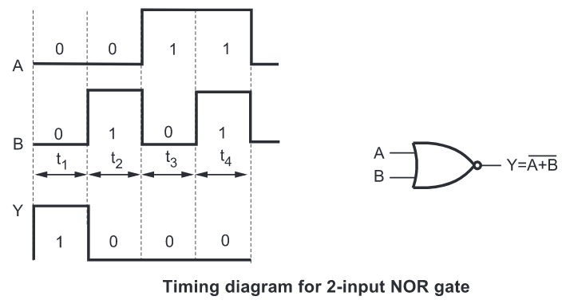

Slide 4
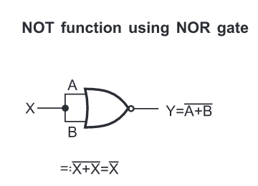
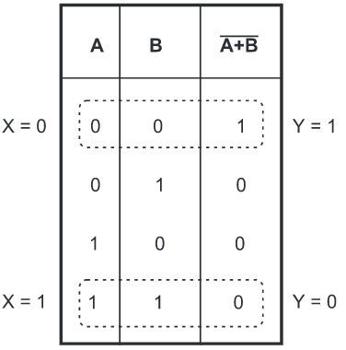

Slide 5

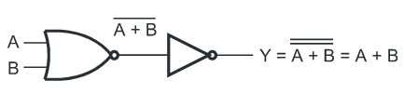


Slide 6
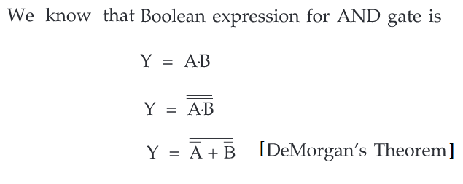

Slide 7

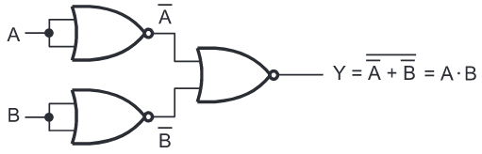

Slide 8
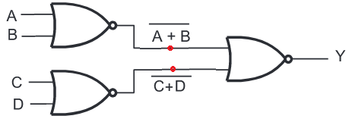



Logic diagram for the function (A+B) (C+D) using NOR gate

Slide 9
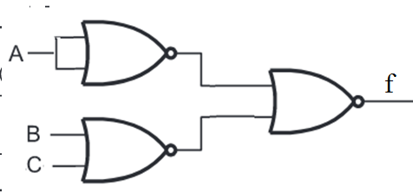
Implement the function f = A (B+C) using minimum number of two-input NOR gates
f = (A+A) (B+C)

Slide 10
How many NOR gates are required to implement the function, f = (A+B) (C+D) (D+E).
f = (A+B) (C+D) (D+E)
(A+B) (C+D) – 3 NOR gates
Assume (A+B) (C+D) = x
f = x (D+E) = (x+x) (D+E) ----- this function requires 3 NOR gates
Total number of NOR gate = 6

Slide 11
Implement the function, f = AD+BE+CD+BD+AE+CE using minimum number of two-input NOR gates.
f = A (D+E) + B (D+E) + C (D+E)
f = (A+B+C) (D+E) ---- (1)
Assume x = B+C
Equation (1) --- f = (A+x) (D+E)

Slide 12
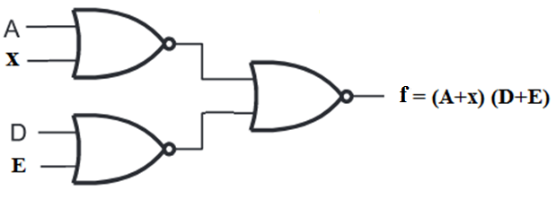
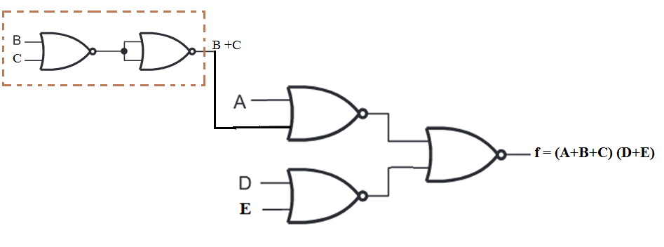

Slide 13

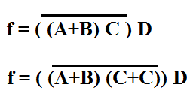
Implement the function using minimum number of NOR gates.

Slide 14
